Slide 1
Unit 202: Principles of electrical science
Connection of meters

Slide 2
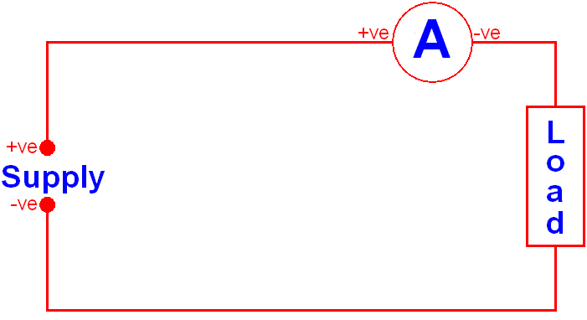
Connection of meters
Ammeter
Ammeters are connected in series

Slide 3
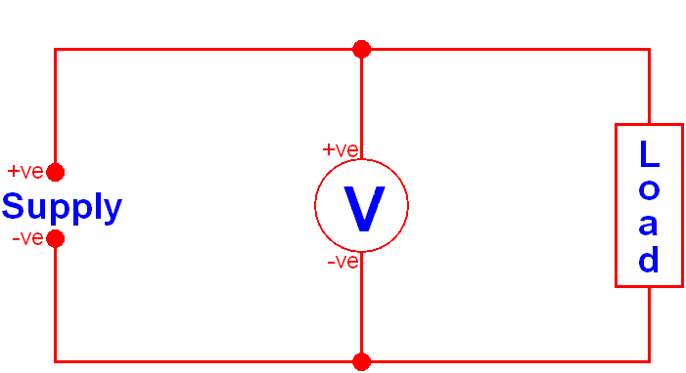
Connection of meters
Voltmeter
Voltmeters are connected in parallel

Slide 4
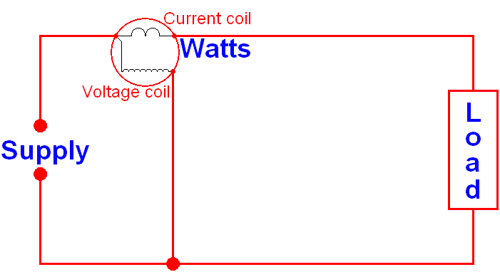
Connection of meters
Wattmeter

Slide 5
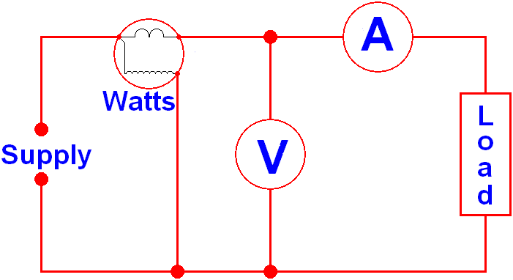
Connection of meters
Power factor measurement

Slide 6
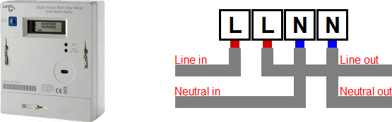
Connection of meters
Energy meter

Slide 7
Unit 202: Principles of electrical science
The End

